Slide 1

Racial Equity Rapid Response Outreach:
Suggested Practices
April 30, 2020

Slide 2
Suggested Outreach Workflow
The workflow illustrated below can be customized to align with a provider’s specific operating model
Additional detail provided
in following slides
Priority patient list
Did patient answer?
Did screening identify issues?
Outreach team performs patient outreach by phone
Outreach team completes screening
Patient is referred to community resources and/or provider care teams for follow-up
Yes
Yes
No
No
Outreach team documents outreach and returns patient to work queue
Patient continues to receive outreach on a regular cadence

Slide 3
Priority Patient List: Suggested Criteria
A prioritized list of patients for outreach can be developed by filtering each provider’s patient population by specific criteria
Filter for all patients with priority profile:
Race/Ethnicity
  Black
  LatinX
Age
  65+
Chronic underlying conditions*
Select patients in top 3-5 zip codes (with highest number of priority patients)**:
Zip code #1
Zip code #2
Zip code #3
Zip code #4
Zip code #5
PRIORITY PATIENT LIST FOR OUTREACH
*Underlying conditions include diabetes, hypertension, chronic lung disease, asthma, heart disease, kidney disease, liver disease, obesity, and immunosuppression
**Once outreach in those top zip codes has been completed, providers move on to patients in other Chicago zip codes and zip codes outside Chicago.
Note: Sources for patient list may include EMR, Medicare lists, ER visits, etc.

Slide 4
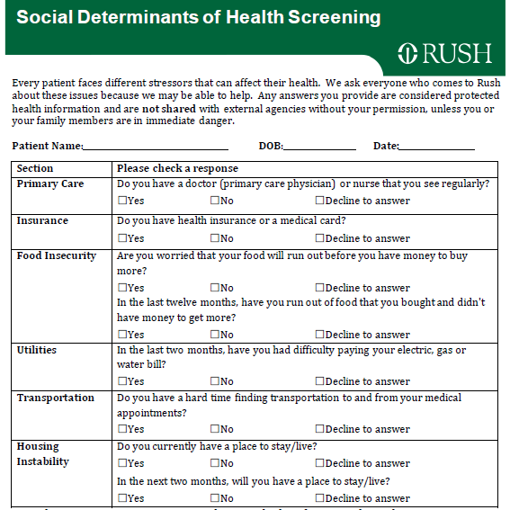
Suggested Components of Screening
Wellness and chronic medical condition checks are most critical; SDoH screening should be included, but may be limited
Components of Screening
Sample Comprehensive SDoH Screening
COVID-19 symptom check
COVID-19 education
  How to reduce risk of infection
  Recognizing symptoms
  Appropriate response to symptoms, including when/how to contact their PCP
Medication check
  Refilling chronic medications, including behavioral health medications
Home management of chronic conditions, e.g.,
  Supplies: Home BP monitor; glucometer
  Follow-up: Internet; phone
Screening for depression, anxiety, and domestic violence
SDoH screening (may be limited)

Slide 5
Suggested Roles and Responsibilities
Successful implementation of targeted outreach will require collaboration across multiple care teams, with different roles and responsibilities
Outreach Lead
  Outreach lead is main RERR point of contact and coordinates outreach efforts across teams. As POC, outreach lead provides regular reporting on agreed-upon metrics, as well as key trends and concerns identified during outreach.
Outreach Team
  Outreach team – comprised of MAs, care managers, CHWs, care coordinators, etc. – conducts preliminary outreach to priority patients; once contact has been made, outreach team conducts screening. Based on screening, outreach team provides patients with referrals to other care team members and connects patients to community resources.
Nursing Team
  Nursing team receives referrals for medication refills and for patients with symptoms who are in need of telehealth or face-to-face appointments. Nursing team may refer patients to primary care providers and others, particularly for patients who have hypertension, diabetes, asthma, COPD, and heart disease.
Social Work Team
  Social work team receives referrals for patients who score high for depression or anxiety, or who have very complex needs that can’t be addressed by the initial caller. Social work team may refer patients to behavioral health providers and others.

Slide 6
Metrics and Reporting
Outreach leads provide weekly progress reports* using metrics included in the chart below, in addition to providing qualitative feedback on key trends and concerns identified during outreach efforts
As of MM/DD/YY | Total | By Race/Ethnicity |  | By Zip Code (Top 3-5 zip codes for priority patients)
 |  | Black | LatinX | Zip Code #1 | Zip Code #2 | Zip Code #3 | Zip Code #4 | Zip Code #5
# of Patients on Priority List
# of Patients Reached (Cumulative)
*Initial response to confirm participation in program is requested by May 8th. Weekly progress reports are requested every Friday, starting on May 15th.

